Slide 1
Multiple Disease Prediction System
By
Divyabharathi

Slide 2
Overview
The Multiple Disease Prediction System is a machine learning-based application designed to assist healthcare professionals in the early detection of Kidney Disease, Liver Disease, and Parkinson's Disease. By leveraging advanced classification algorithms, the system provides quick and accurate predictions, reducing the need for expensive tests and aiding in timely intervention.

Slide 3
Models & Methodologies: Machine Learning Algorithms Used
Kidney Disease Prediction:
Liver Disease Prediction:
Parkinsons Disease Prediction:
Algorithm: Decision Tree Classifier.
Key Features: Serum Creatinine, Hemoglobin, Specific Gravity, Diabetes Mellitus, Hypertension,etc.
Preprocessing:
Categorical features encoded using Label Encoding.
Missing values imputed using random values/mode imputation.
Smote used to do oversampling.
Feature selection done by feature importance.
Algorithms: Light Gradient Boost Classifier.
Key Features: Age, Total Bilirubin, Albumin, Alkaline Phosphotase, aspartate_aminotransferase.
Preprocessing:
Removed duplicates and dropped missing values.
Gender encoded as numerical values (Male=0, Female=1).
Smote used to do oversampling.
Feature selection done by feature importance.
Algorithms: Random Forest Classifier.
Key Features: MDVP:Fo(Hz), MDVP:PPQ, HNR, Spread1, Spread2, PPE.
Preprocessing:
Smote used to do oversampling.
Feature selection done by feature importance.
Data standardization done using Standard Scaler

Slide 4
Kidney Disease Prediction

Slide 5
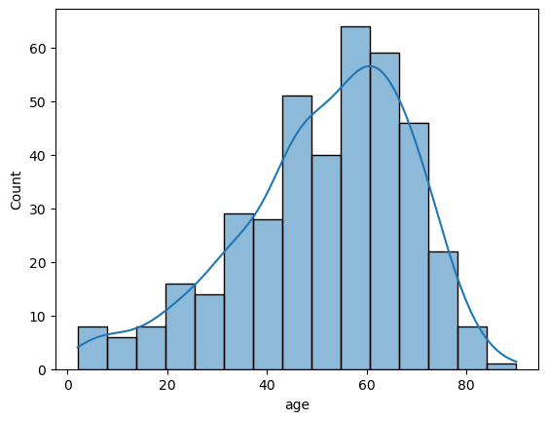
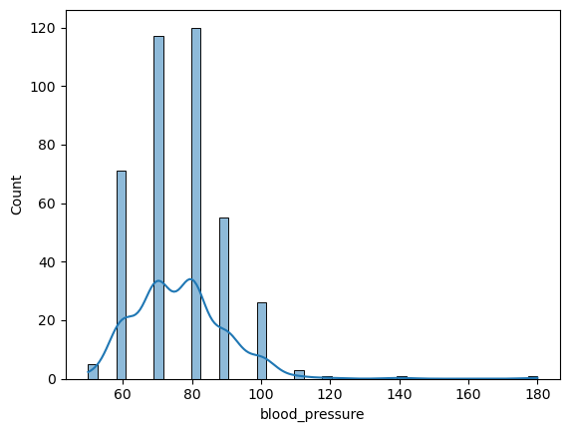
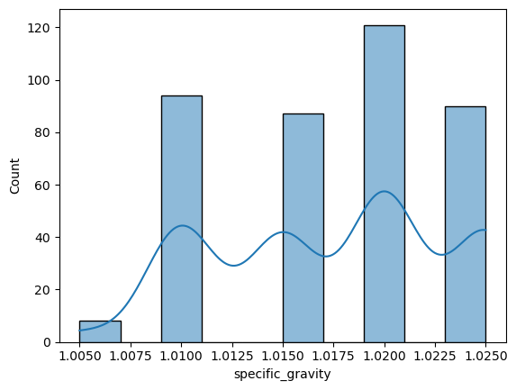
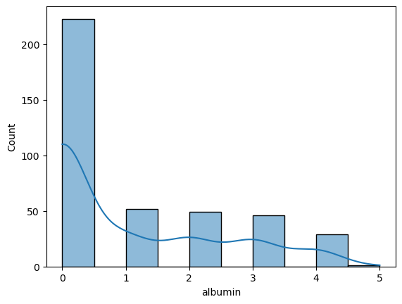
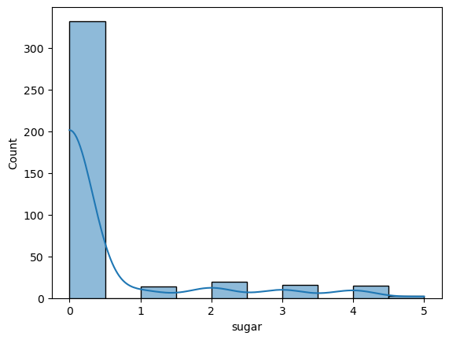
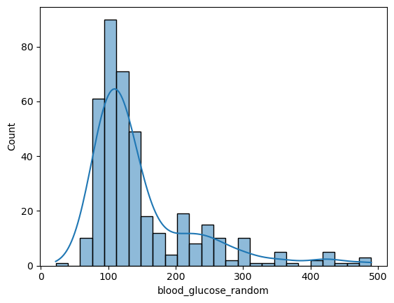
Univariate Numeric

Slide 6
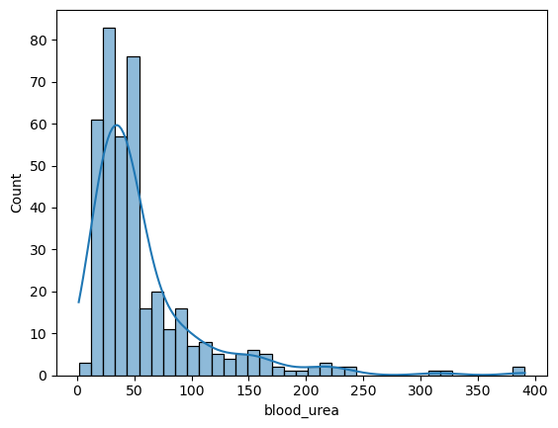
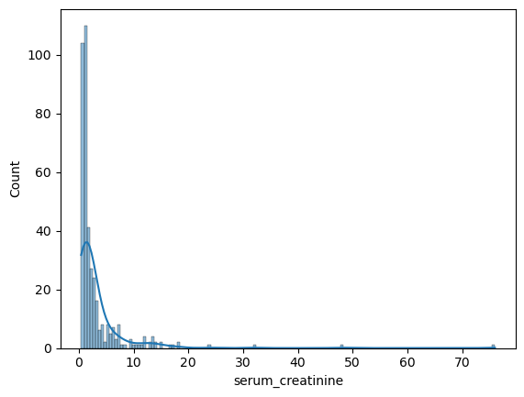
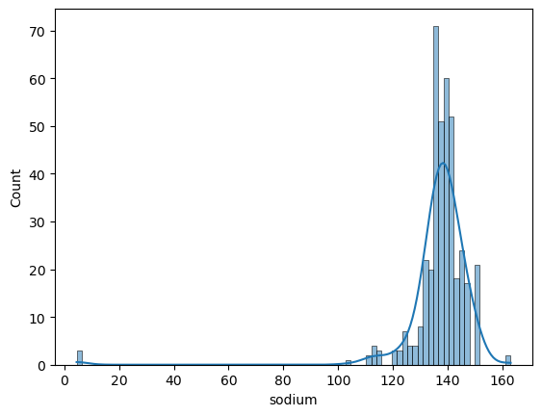
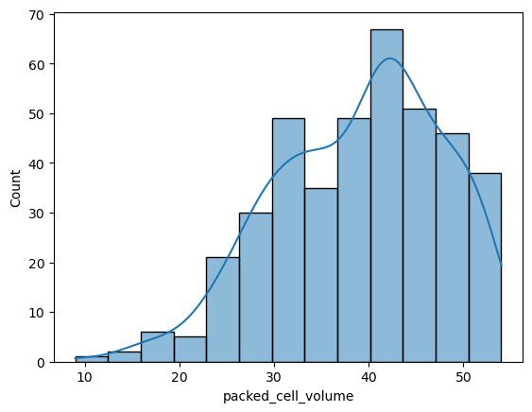
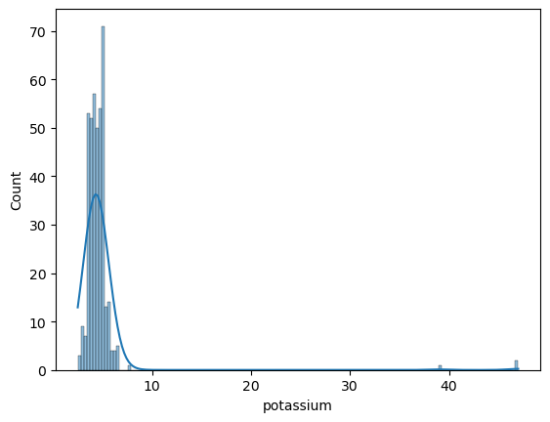
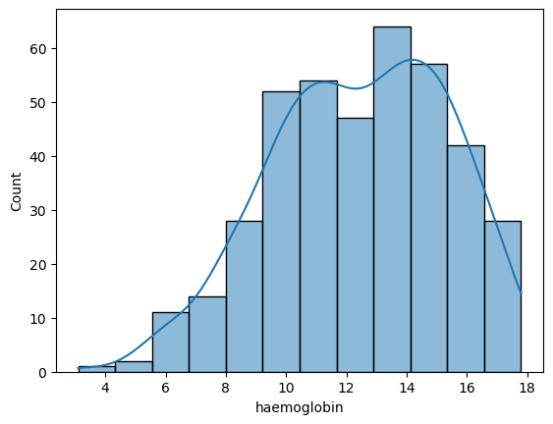
Univariate Numeric

Slide 7
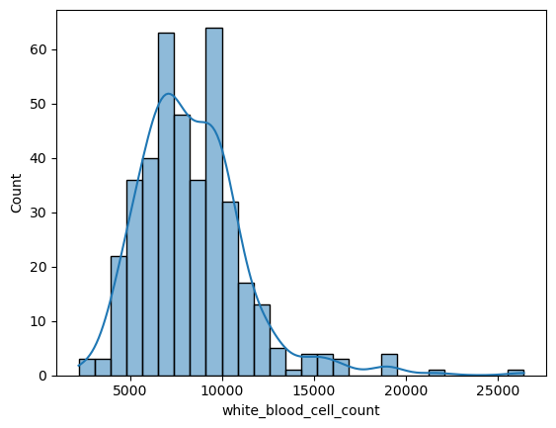
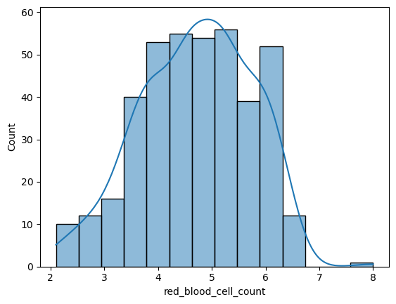
Univariate Numeric

Slide 8
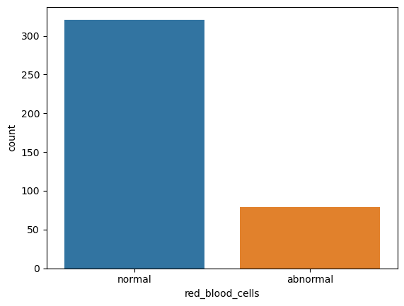
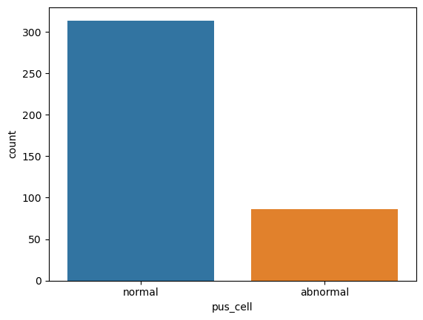
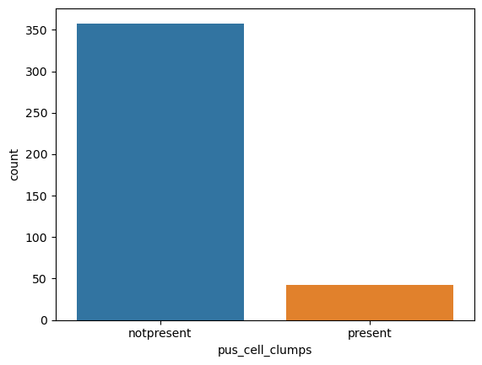
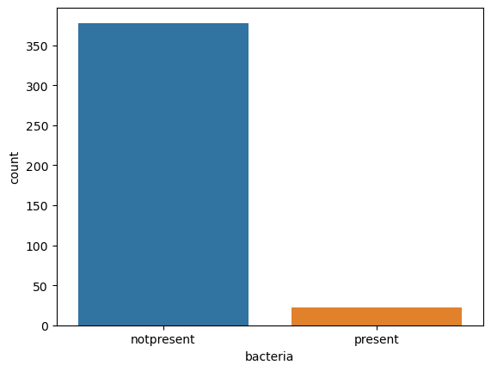
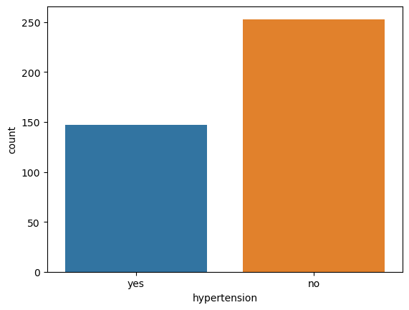
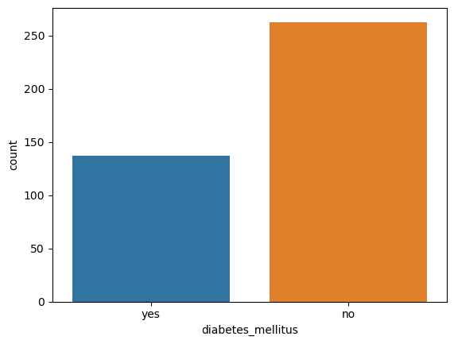
Univariate Categorical

Slide 9
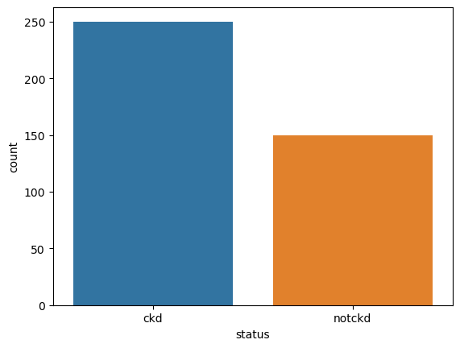
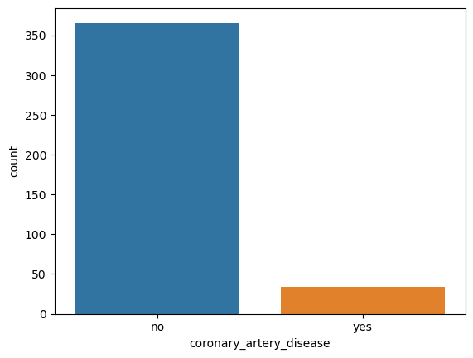
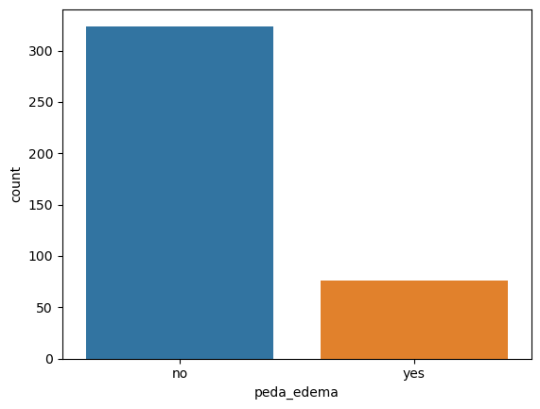

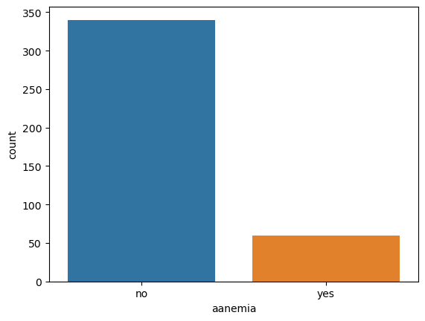
Univariate Categorical

Slide 10
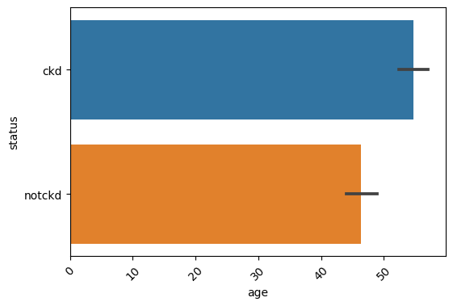
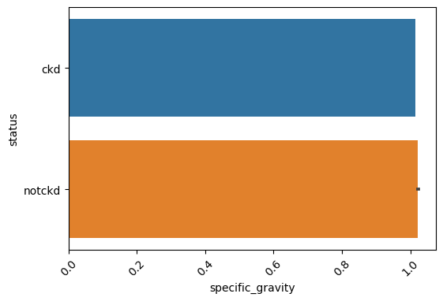
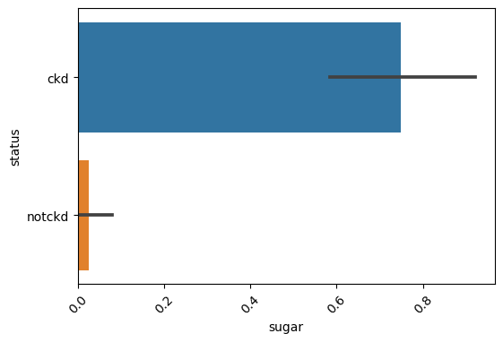
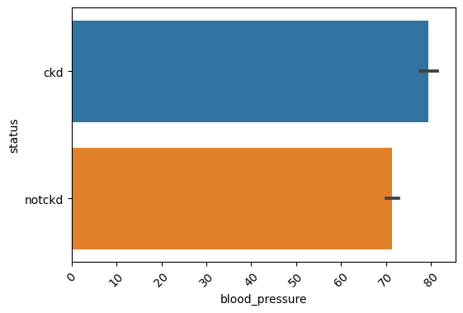
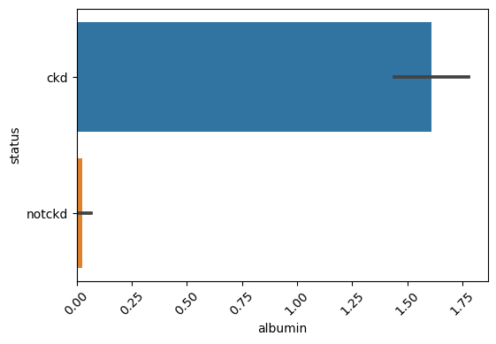
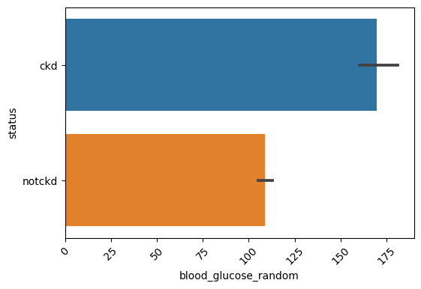
Bivariate: Numeric Vs Categorical

Slide 11
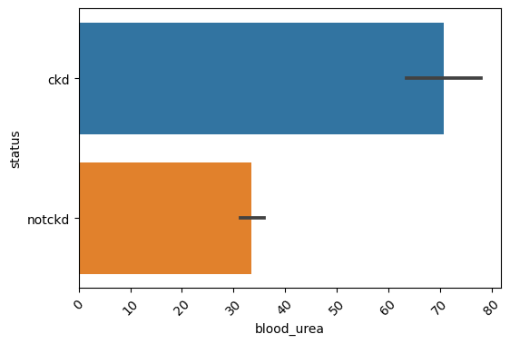
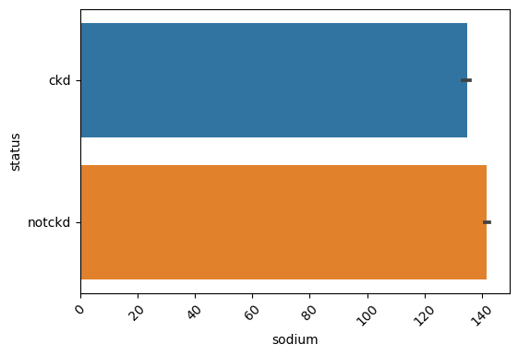
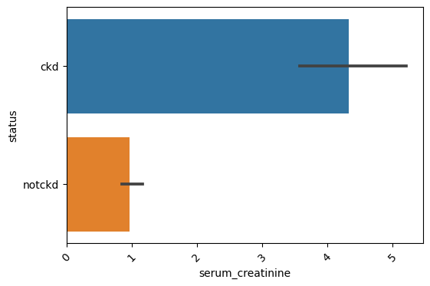
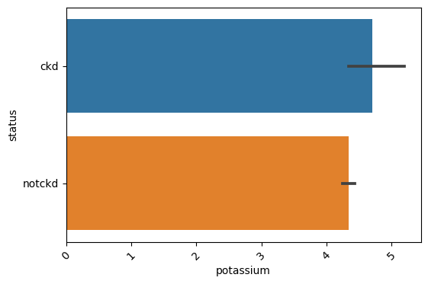
Bivariate: Numeric Vs Categorical

Slide 12
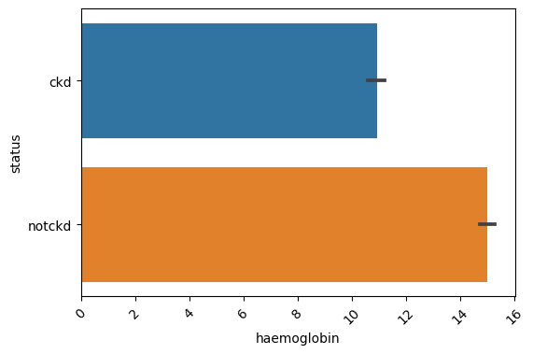
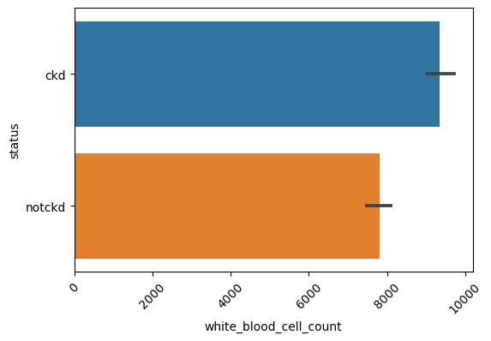
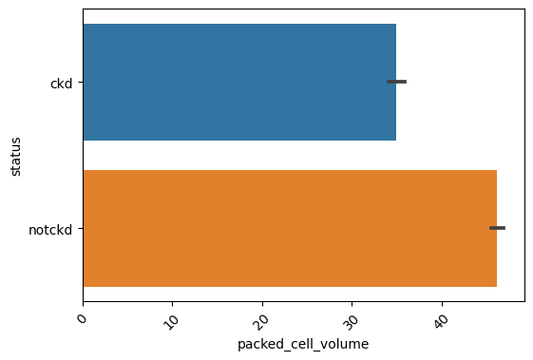
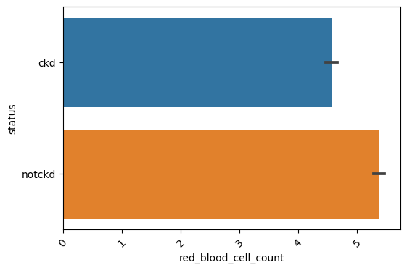
Bivariate: Numeric Vs Categorical

Slide 13
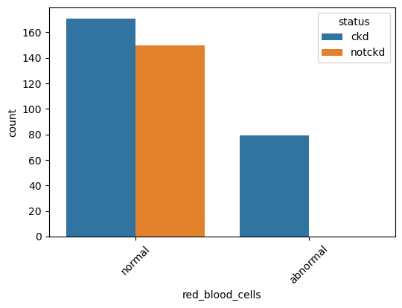
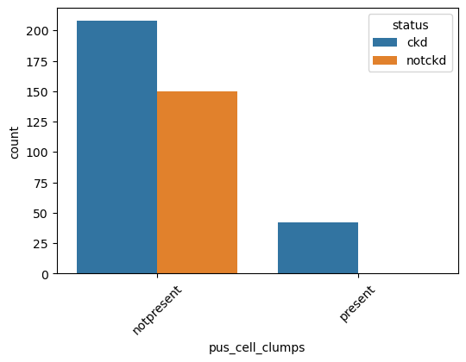
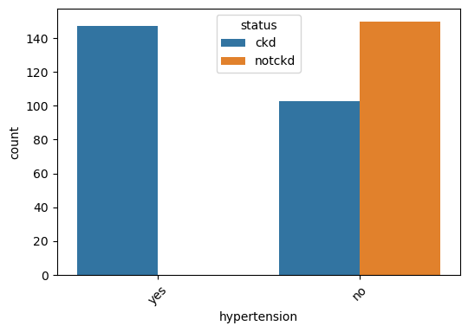
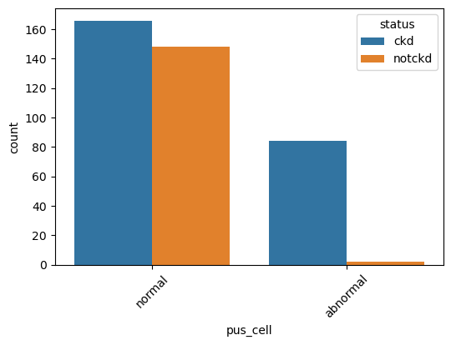
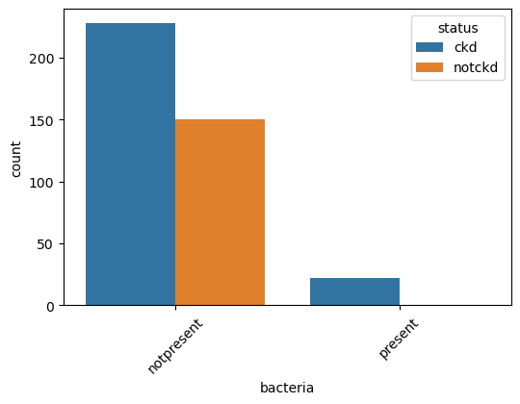
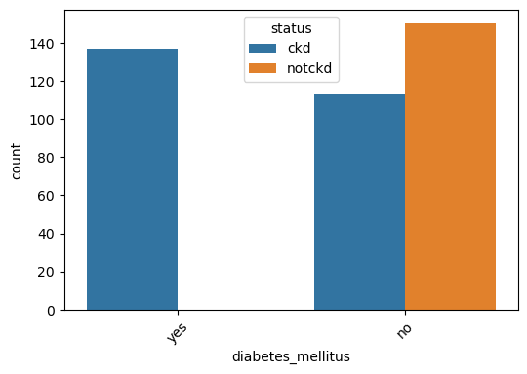
Bivariate: Categorical Vs Categorical

Slide 14
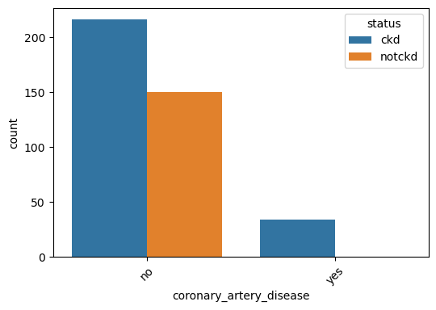
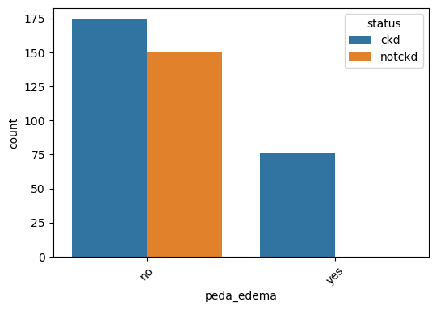
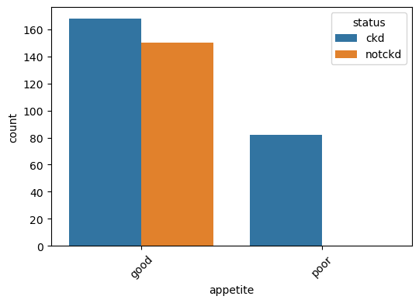
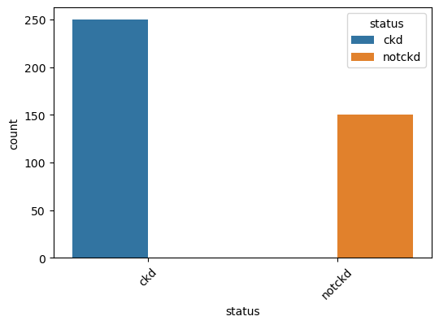
Bivariate: Categorical Vs Categorical

Slide 15
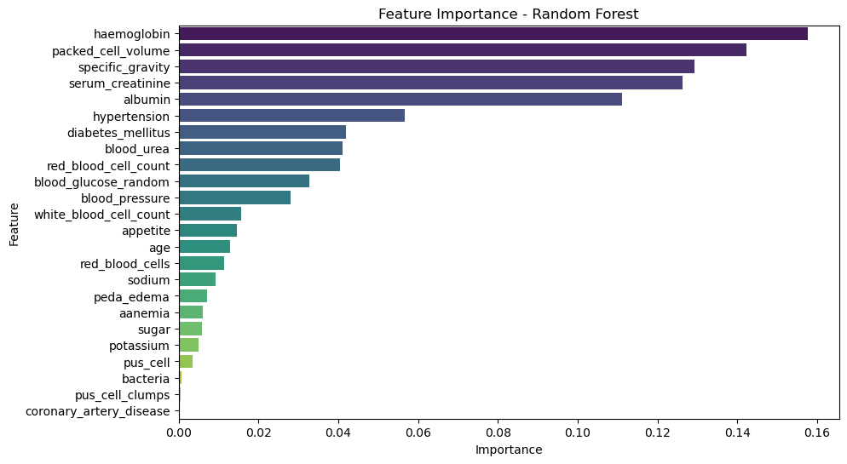
Feature Selection

Slide 16
Model Selection based on Score
Model | Score
Random Forest Classifier | 1
Ada Boost Classifier | 1
Gradient Boost Classifier | 0.99
XgBoost Classifier | 0.99
Light GBoost Classifier | 0.99
Neive Bayes Classifier | 0.97
Decision Tree Classifier | 0.96
K-Nearest Neighbors Classifier | 0.91
Support Vector Classifier | 0.9

Slide 17
Liver Disease Prediction

Slide 18
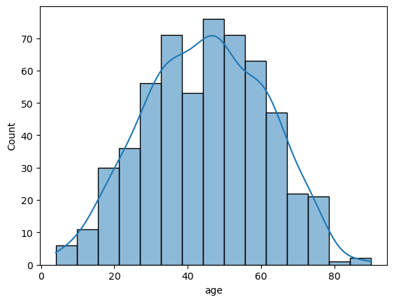





Univariate Numeric

Slide 19



Univariate Numeric

Slide 20






Bivariate: Numeric Vs Categoric

Slide 21




Bivariate: Numeric Vs Categoric
Bivariate:
Categoric Vs Categoric

Slide 22

Feature Selection

Slide 23
Model Selection based on Score
Model Evaluation Metrics:
Accuracy: Measures overall correctness.
Precision & Recall: Helps in assessing the model's reliability for disease detection.
F1-Score: Ensures a balance between Precision & Recall.
Model | Score
XgBoost Classifier | 0.7963
Light GBoost Classifier | 0.79012
Random Forest Classifier | 0.74691
Gradient Boost Classifier | 0.74074
Decision Tree Classifier | 0.71605
Ada Boost Classifier | 0.7037
K-Nearest Neighbors Classifier | 0.68519
Neive Bayes Classifier | 0.67284
Support Vector Classifier | 0.64198

Slide 24
Parkinsons Disease Prediction

Slide 25










Univariate Numeric

Slide 26











Univariate Numeric

Slide 27
Bivariate

Slide 28

Feature Selection

Slide 29
Model Selection based on Score
Model | Score
XgBoost Classifier | 0.98305
K-Nearest Neighbors Classifier | 0.98305
Light GBoost Classifier | 0.94915
Random Forest Classifier | 0.91525
Support Vector Classifier | 0.89831
Decision Tree Classifier | 0.88136
Ada Boost Classifier | 0.88136
Gradient Boost Classifier | 0.81356
Neive Bayes Classifier | 0.81356

Slide 30


Slide 31


Slide 32


Slide 33
Key Findings
Kidney Disease Model:
Achieved an F1-Score of 0.89, with 92% accuracy on test data.
Important features: Serum Creatinine, Hemoglobin, Blood Urea.
Most patients with high Serum Creatinine (>2.0 mg/dl) were classified as CKD positive.
Liver Disease Model:
Achieved an F1-Score of 0.84.
Important predictors: Albumin, Total Bilirubin, Alkaline Phosphotase.
Higher Total Bilirubin was a strong indicator of liver disease.
Parkinson’s Disease Model:
Achieved 91% accuracy with Random Forest.
Top predictive features: MDVP:Fo(Hz), HNR, Spread1.

Slide 34
Business Insights & Impact
Faster Diagnosis: Reduces diagnostic time for chronic diseases.
Cost Savings: Helps in screening patients before expensive lab tests.
Scalability: Can be expanded to include more diseases.
User Engagement: Interactive web app for patient and doctor usage.

Slide 35
Future Scope & Improvements
Integrate More Diseases: Extend the model to predict more conditions.
Improve Accuracy: Tune hyperparameters and try deep learning.
Real-time Data Analysis: Integrate with electronic health records.
Multi-language Support: Make the interface accessible in different languages.

Slide 36
Conclusion
The Multiple Disease Prediction System bridges the gap between AI and healthcare, allowing for quick, cost-effective, and reliable disease detection. With further improvements and data collection, it has the potential to be a game-changer in preventive healthcare.

